Slide 1


KURSUS PELATIHAN DASAR MENGENAI PERLINDUNGAN PERNAPASAN

Slide 2
BAGAIMANA MELINDUNGI DIRI ANDA DARI MENGHIRUP ABU VULKANIK

Slide 3
MENGAPA
Anda harus memakai perlindungan pernapasan
Notes:
Breathing volcanic ash can be a nuisance and cause discomfort, and may have more serious health effects for some people.
The most effective way to reduce exposure is to shelter somewhere which is not ashy, ideally inside a building.
However, this may not be practical and one way to reduce your exposure when outside or cleaning-up is to wear respiratory protection.
The purpose of respiratory protection is to prevent hazardous materials from entering your body through the lungs and causing serious damage to your body, your organs, and your health.

Slide 4
Debu
dari abu vulkanik
Notes:
Volcanic ash is a form of dust and can be created in vast quantities from a volcanic eruption

Slide 5
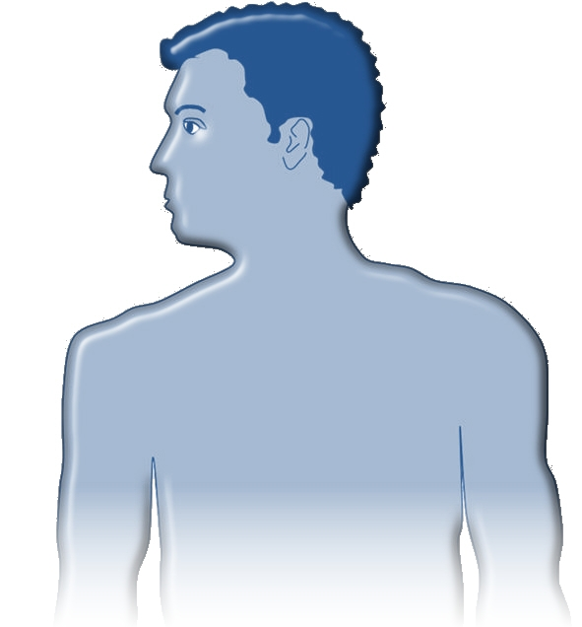
Kita perlu melindungi paru-paru kita
✗
Debu dalam jumlah yang besar
(Dapat membuat perlindungan alami tubuh kewalahan)
✗
Partikel-partikel debu beracun
(Dapat merusak paru-paru dan juga bagian tubuh yang lain)
✗
Partikel-partikel debu sangat kecil
(Dapat melewati sebagian besar perlindungan alami tubuh untuk memasuki paru-paru)
Notes:
Our respiratory system can cope with most everyday particles like dusts around the house etc but there are problems with the following situations:
Large quantities of dust can overwhelm our body’s natural defences
Toxic or poisonous dust can damage our lungs, our defences as well as other parts of the body
Very small dust particles can bypass most of the natural defences and get deep into the lung tissues where they can cause serious harm especially if they are toxic or in large quantities…
5

Slide 6
Saya merasa OK
Mengirup debu dapat menyebarkan dampak jangka panjang bagi kesehatan Anda. Dampaknya mungkin tidak dirasakan segera.
Notes:
Many breathing hazards have no IMMEDIATE effect.
• They have DELAYED effects, so you may not notice that you are breathing in toxic materials.
• You may become ill many days later, or after a very long time of exposure to volcanic ash.

Slide 7
Respirator bersertifikat
(Certified respirator)
Pelindung pernapasan yang paling efektif untuk orang dewasa adalah dengan mengenakan respirator bersertifikat yang sesuai
Sering disebut sebagai masker ‘N95’ (juga disebut FFP2 atau FFP3 atau DS2 di berbagai negara lainnya)
Sertifikasi umumnya dicetak pada respirator
Masker-masker ini sangat efisien dalam menyaring abu dan telah dirancang sesuai dengan bentuk wajah orang dewasa
Notes:
The most effective respiratory protection for adults is to wear a well-fitting certified respirator
Often called a ‘N95’ mask (also called FFP2 or FFP3 or DS2 in different parts of the world)
The certification will be printed on the respirator
These are highly efficient at filtering ash and are usually designed to fit adult faces well

Slide 8
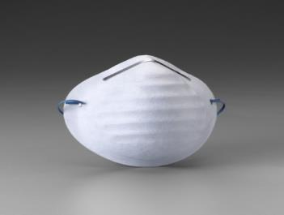

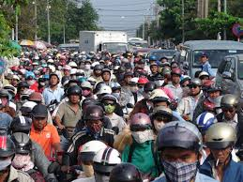
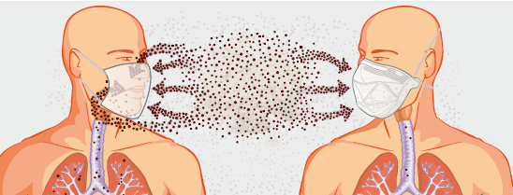
APAKAH YANG BUKAN Respirator
Masker wajah
(Face mask)
Respirator
Notes:
While they may look similar there is a difference between a face mask and a certified respirator. It is important to understand the difference.
A respirator is:
designed to offer respiratory protection
designed to filter out small and large dust particles
designed to fit well to the wearer’s face
tested to international recognized standards
A face mask is NOT:
designed to offer respiratory protection
designed to filter out small and large particles of dust
designed to fit well to the wearer’s face
Always tested to international recognized standards – refer to any markings

Slide 9
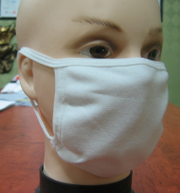
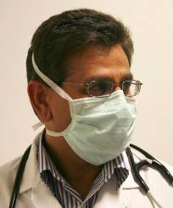
Apakah Masker atau Masker Bedah?
Dikenakan untuk menghindari tetesan air yang mungkin keluar dari pengguna mengenai orang lain
Pada umumnya tidak memiliki bahan penyaring elektrostatis (electrostatically charged filter material)
Kemungkinan tidak dirancang untuk menyegel dengan ketat ke wajah – kebocoran udara pada pinggiran-pinggiran biasanya terjadi

Slide 10
Bagaimana sebuah respirator bekerja?
Menyingkirkan debu dari udara dengan:
Membentuk segel yang baik antara wajah dan respirator
Menahan udara melewati bahan penyaring
Bahan penyaring menyaring keluar debu
Celah antara wajah dan respirator dapat menyebabkan debu dihirup
Notes:
Respiratory work
by forming a good seal between face and respirator
which forces the air that we breathe to pass through the highly efficient filtering materials which filters out the ash particles
Sometimes the respirator may have a valve fitted – this is an exhalation valve. The exhalation valve helps to increase comfort and makes it easier to breathe. More on this later.

Slide 11
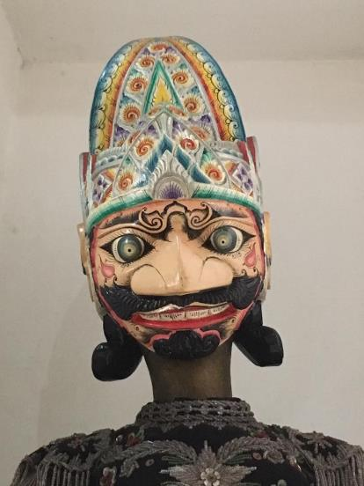
Rambut wajah (Facial hair)
Rambut wajah di sekitar segel wajah dapat membuat celah yang mengizinkan udara dan, sehingga, abu bocor ke dalam respirator
Ketika Anda memakai respirator, coba untuk mencukur bersih bagian sekitar respirator yang menyentuh wajah Anda
Notes:
Respiratory work by forming a good seal between face and respirator and therefore if there is any facial hair in the region of the face seal then this will create a gap that will allow air and ash to leak into the respirator.
This applies to any form of face mask

Slide 12
RINGKASAN (SUMMARY)
Menghirup abu vulkanik dapat berpengaruh terhadap kesehatan Anda
Gunakan respirator bersertifikat untuk membantu menyaring abu vulkanik dari udara yang Anda hirup
Periksa dan sesuaikan respirator Anda seperti yang ditunjukkan
Ketika (respirator) kotor, rusak atau menghirup menjadi sulit, ganti dengan respirator baru
Perlindungan pernapasan yang baik akan melindungi Anda dari bahaya-bahaya ketika menghirup abu vulkanik
Notes:
Breathing in volcanic dust can effect your health
Using a certified respiratory will help to filter out volcanic ash from the air that your breath
Check and fit your respirator correctly as shown
When dirty, damaged or breathing becomes difficult replace with a new respirator
GOOD RESPIRARTORY PROTECTION WILL PROTECT YOU FROM THE HAZARDS OF BREATHING IN VOLCANIC ASH

Slide 13
BAGAIMANA
cara menggunakan respirator Anda
Notes:
It is important to know how to use your respirator in order to achieve the best possible protection for your health and wellbeing.

Slide 14
KENALI
respirator Anda
Notes:
You should be as familiar with your respirator as you are with your shoes or clothes.
• The better you know your respirator the better you can use it, the better you will be at training others and the better the protection you will achieve.

Slide 15
Tali bagian kepala
(Head strap)
Kawat hidung
(Nose clip)
Kawat hidung
(Nose clip)
Katup pernapasan
(Exhalation valve)
(Dimana terpasang)
(where fitted)
Bahan penyaring
(Filtering material)
Tanda sertifikasi
(Certification markings)
Notes:
Let’s talk through and explain the purpose of the parts of the respirator
Headstraps – there are usually two head straps fitted to your respirator. The headstraps are deigned to hold the respirator firmly on your face.
Filtering material – certified respirators have highly efficient filter material which is capable of filtering out very-small to large particles.
The shape of the filtering is designed to fit well to the wearer’s face
Nose clip – the nose clip is designed to be shaped around the nose and under the eyes to form a leaktight seal between the respirator and the wearer’s face
Exhalation valve - The exhalation valve helps to increase comfort by reducing the build up of warm air inside the respirator, and makes it easier to breathe by allowing your exhaled air to pass out of the respirator easier and quicker.
Certification markings – Respirators are tested and certified to internationally recognised standards and this will be marked on the respirator.

Slide 16
PERIKSA
sebelum Anda gunakan
Notes:
Before every use, make sure your respirator is clean, intact and fully functional.
Check for damage to the filtering material, the head straps and valve (if fitted)

Slide 17
JANGAN GUNAKAN JIKA…
rusak
kotor
sulit digunakan untuk bernapas
Notes:
If you have ANY doubts about the condition of your respirator, do not use it and get a new respirator.

Slide 18
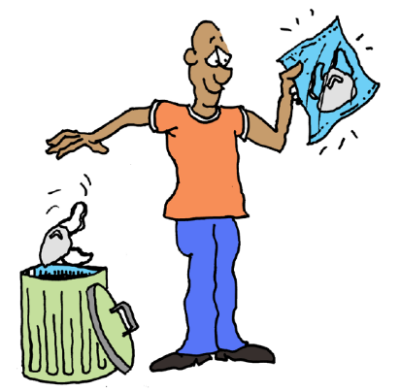
KAPAN
harus mengganti masker Anda
Notes:
Your respirator must be replaced regularly.
• A new respirator gives you protection, and is easy to breathe through.
• If you wear your respirator too long, it may give you less protection, or become hard to breathe through.
• A respirator that has been used too long may become damaged or soiled, increasing the risk of exposure to dust.

Slide 19
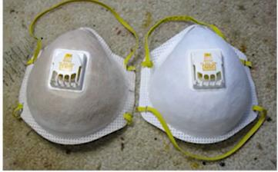
Ganti masker Anda
Notes:
Disposable respirators may be designed for single use (so packaging will often state that they should be disposed of after 8 hours) but they can be worn until you notice that they are clogged and/or breathing becomes harder, or if you notice the mask starting to break. However, you may choose to replace them sooner for hygiene reasons and should check frequently for any degradation or growth of mould.
Some industry-certified respirators have a ‘use-by’ date printed on them. After this date, the manufacturer cannot guarantee the integrity of the respirator materials.

Slide 20
Keliru!
Jangan CUCI
respirator Anda
- sebaliknya gunakan (respirator) yang baru
Notes:
Never try to wash or clean your respirator to recycle it or to make it last longer.
• It is always better to wear a new respirator instead of a used one.

Slide 21
SIMPAN
respirator-respirator
yang tidak digunakan di tempat bersih
simpan di kantung atau kotak yang bersih untuk digunakan kembali
Notes:
Store unused respirators in a clean place following the manufacturers’ guidance on storage conditions
When reusing respirators store in-between in a clean bag or box

Slide 22
GUNAKAN
respirator Anda
SEPANJANG WAKTU
ketika terpapar debu
Notes:
You should try not to remove your respirator while you are in a dusty area — not even for a very short time.
• Keep your respirator on 100% of the time!
However, don’t wear any mask when sleeping.

Slide 23
Jangan BERBAGI
respirator Anda dengan orang lain
Notes:
Your respirator is a personal item.
• Never swap or share respirators with other people.
• If you use somebody else’s respirator, you will not know the condition of the respirator.
• Sharing respirators means poor hygiene, and can easily spread disease.

Slide 24
BAGAIMANA CARA MENGENAKAN
respirator Anda

Slide 25
LANGKAH 1
Dengan tangan bersih, ambil masker dari kemasan. Hindari mengontaminasi bagian dalam masker dengan abu.
Notes:
With clean hands, take the mask out of the packaging. Avoid contaminating the inside of the mask with ash.

Slide 26
LANGKAH 2
Buka lipatan pada masker dan rentangkan tali pengikat pada masker ke bagian belakang kepala atau telinga.
Notes:
Open up any flaps and prepare the strap for placing around the head

Slide 27
LANGKAH 3
Letakkan masker menutupi hidung dan mulut. Tarik tali ke belakang kepala, dengan tali bagian atas di atas telinga Anda, di sekitar kepala belakang bagian atas, dan tali bagian bawah di bawah telinga Anda.
Notes:
Fit the mask over the nose and mouth. Fit any straps to the head, with the top strap around the top of your head, above your ears.

Slide 28
LANGKAH 4
Pastikan tali pengikat bagian bawah berada di bawah telinga Anda, mendekati bagian bawah wajah Anda. Eratkan tali sehingga masker menutup dengan rapat dan nyaman.
Notes:
Make sure the lower strap is below your ears, towards the bottom of your head. Tighten the straps/ loops until the mask makes a seal around your face and is comfortable.

Slide 29
LANGKAH 5
Dengan kedua tangan, tekan rangka kawat di atas hidung secara perlahan sehingga menutupi hidung dan bagian wajah di bawah kedua mata. Jangan jepit kawat tersebut.
Notes:
With both hands, gently press any nose clip so that it fits well across the nose and onto the face below the eyes. Do not pinch the clip.
Using two fingers from both hands shape the nose clip around your nose working from the bridge of your nose down both sides and under your eyes

Slide 30
LANGKAH 6
Tutup masker dengan kedua tangan Anda, dengan hati-hati tanpa mengubah posisinya. Hembuskan napas dengan kencang untuk memeriksa jika ada kebocoran udara di pinggiran masker. Atur kembali jika Anda merasakan ada kebocoran.
Notes:
You should test the fit every time you use your respirator
Cover the mask and exhalation valve (if fitted) with both hands, being careful not to change the fit. Breathe out sharply (like if you are blowing out candles on a birthday cake) to check for air leakage around the mask edges. Adjust fit if there are leaks.

Slide 31
RINGKASAN
Selalu gunakan respirator yang bersih, utuh, dan berfungsi dengan baik
Ganti respirator Anda sesegera mungkin ketika diperlukan
Jangan berbagi respirator dengan orang lain
Periksa respirator Anda sebelum dipakai
Kenakan respirator Anda 100% sepanjang waktu ketika berada di area berdebu
Ketahui bagaimana cara mengenakan respirator dengan baik
Periksa kebocoran setiap kali sebelum digunakan
Notes:
Know how your respirator works, and what it does.
• Always use a clean, intact, functional respirator.
• Replace your respirator as soon as necessary.
• Never share respirators with others
• Check your respirator before each use.
• Wear your respirator 100% of the time while in a dusty area.
• Know how to fit the respirator properly.
• Test for leakage before every use.

Slide 32
TERIMA KASIH
ADA PERTANYAAN?

